Slide 1
AI/ML Inventory Detection
Recording inventory automatically using ai/ml for historical analysis
Kevin Tran
Cloud Consultant
KTPTRAN LLC

Slide 2
Table of Contents
Overview
Storyboard
Demo
Future State
Conclusion

Slide 3
Project Overview
Objective and Key Results (OKRs)
Provide a platform to automatically record down item inventory.
Provide an interface to view the historical trends.
Key Performance Indicators (KPIs)
Record inventory stock within seconds
Provide a web platform to view configuration and historical trends

Slide 4
Storyboard

Slide 5




User Generating Data
Users authenticate through the web platform & generate a snapshot of the inventory.
The snapshot asset is saved in Amazon S3 storage.
The snapshot is processed and analyzes the count of objects using Amazon Rekognition.
The count of objects and image location is recorded into Amazon Timestream for auditing.

Slide 6

Viewing Historical Inventory
Users authenticate through the web platform & view the inventory.
Historical inventory with timestamps is retrieved from storage.
Clicking on any point retrieves the associated image from Amazon S3.

Slide 7
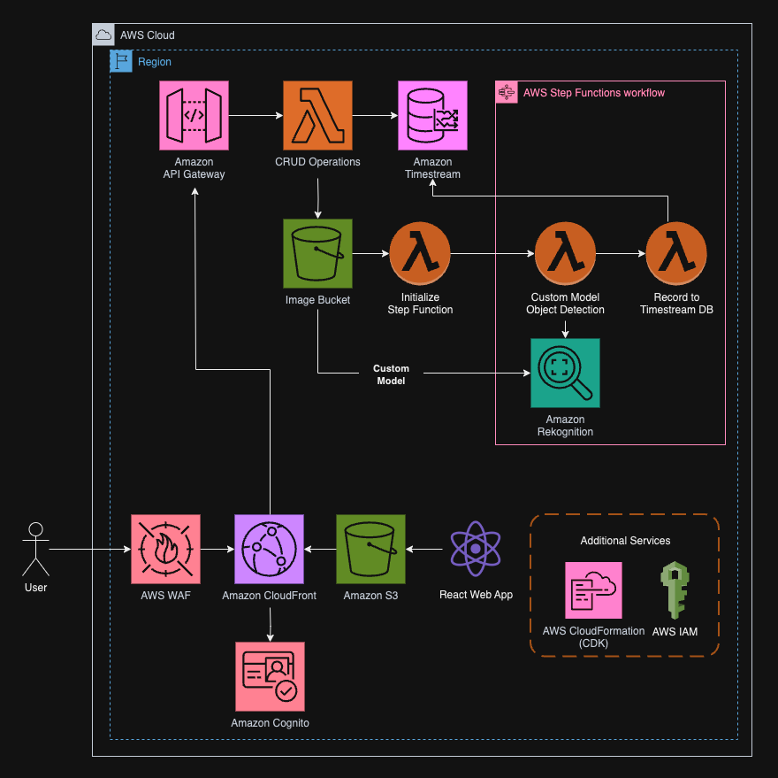
Architecture Diagram

Slide 8
Demo

Slide 9
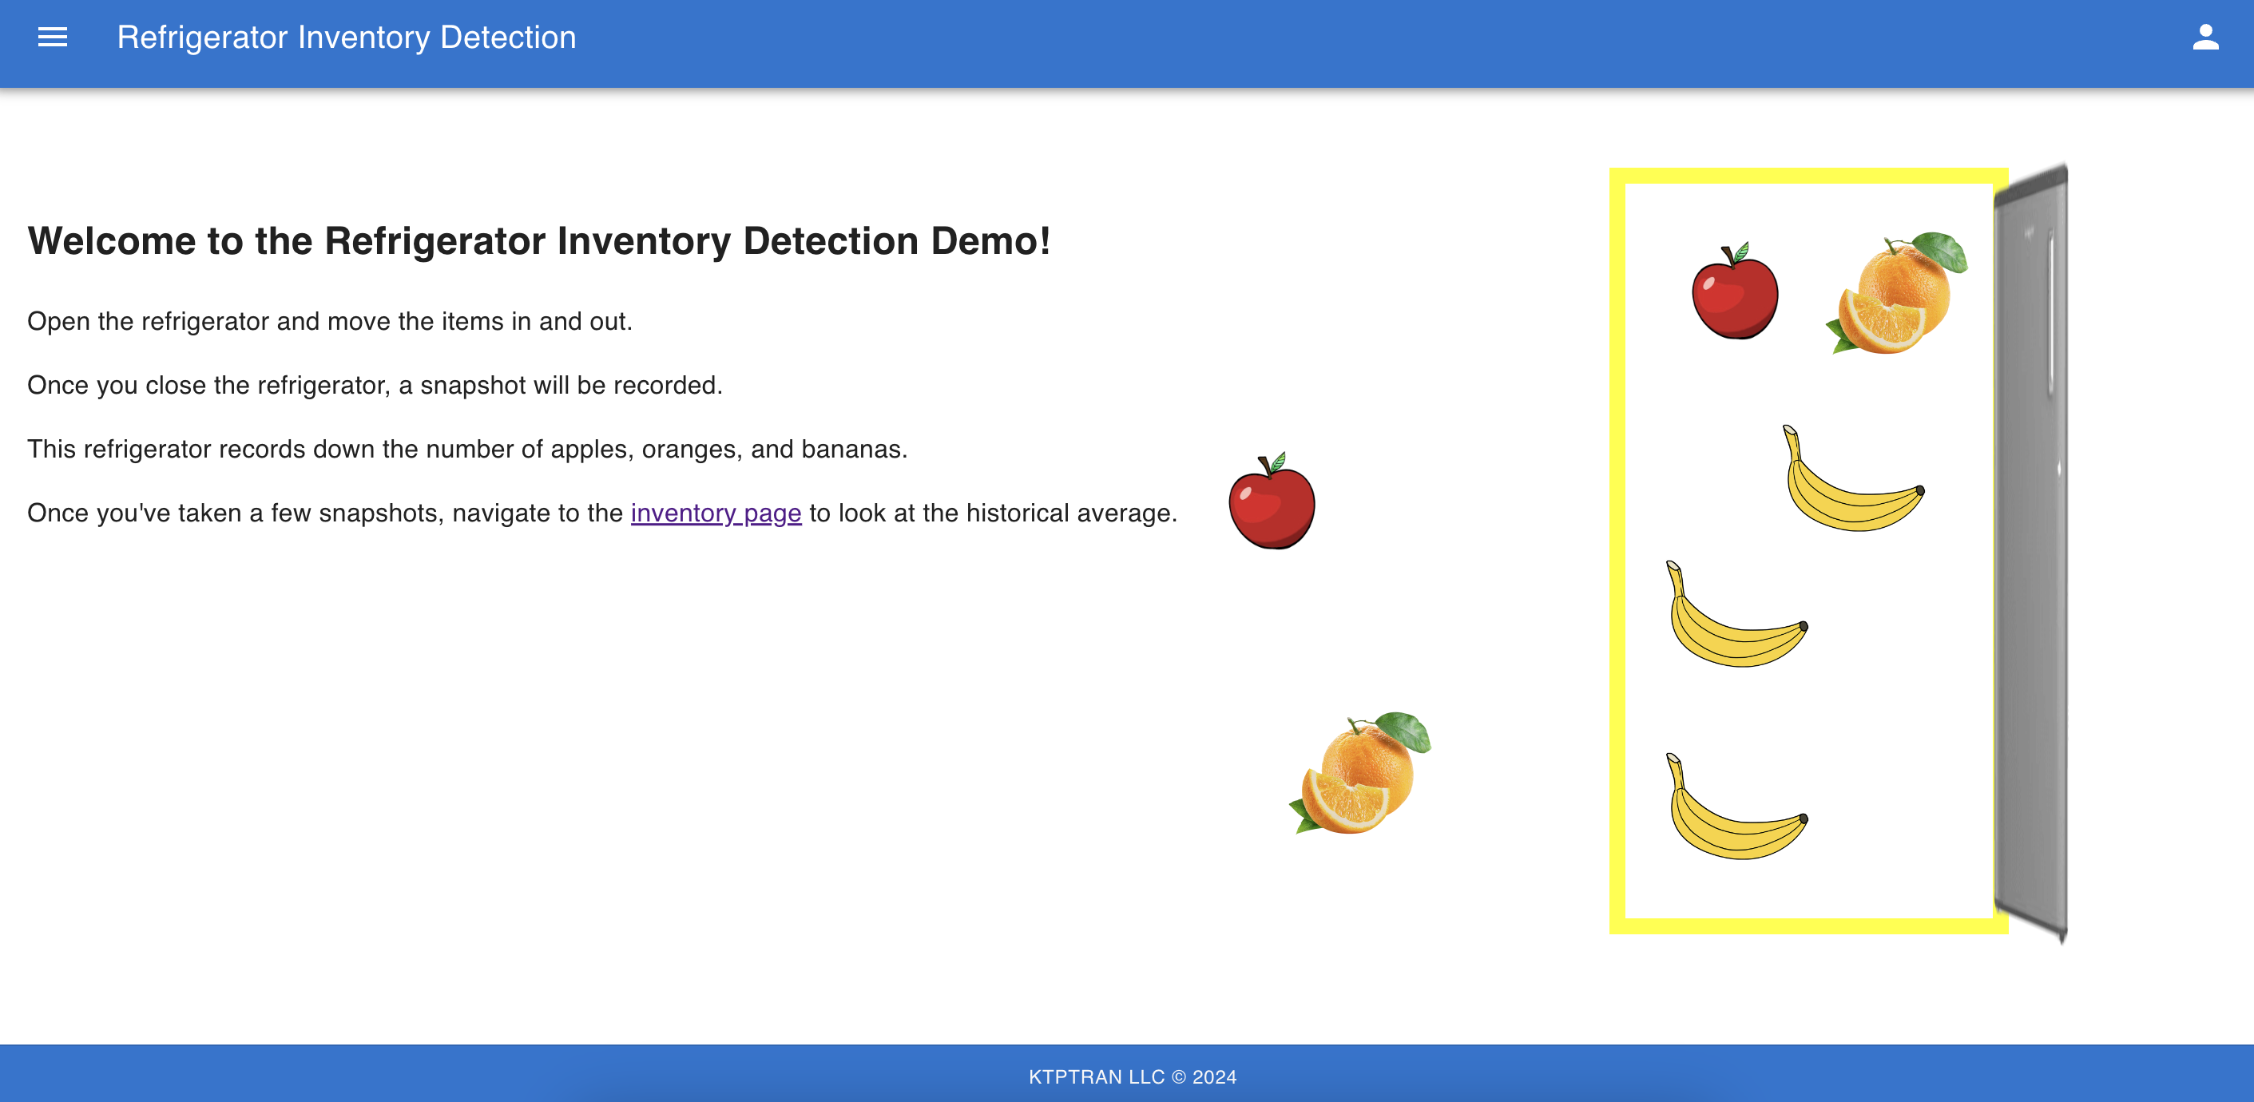
Recording Inventory
After logging into the system, open the refrigerator and move around the fruits. Once you close the fridge, a snapshot will be saved and analyzed to record.

Slide 10
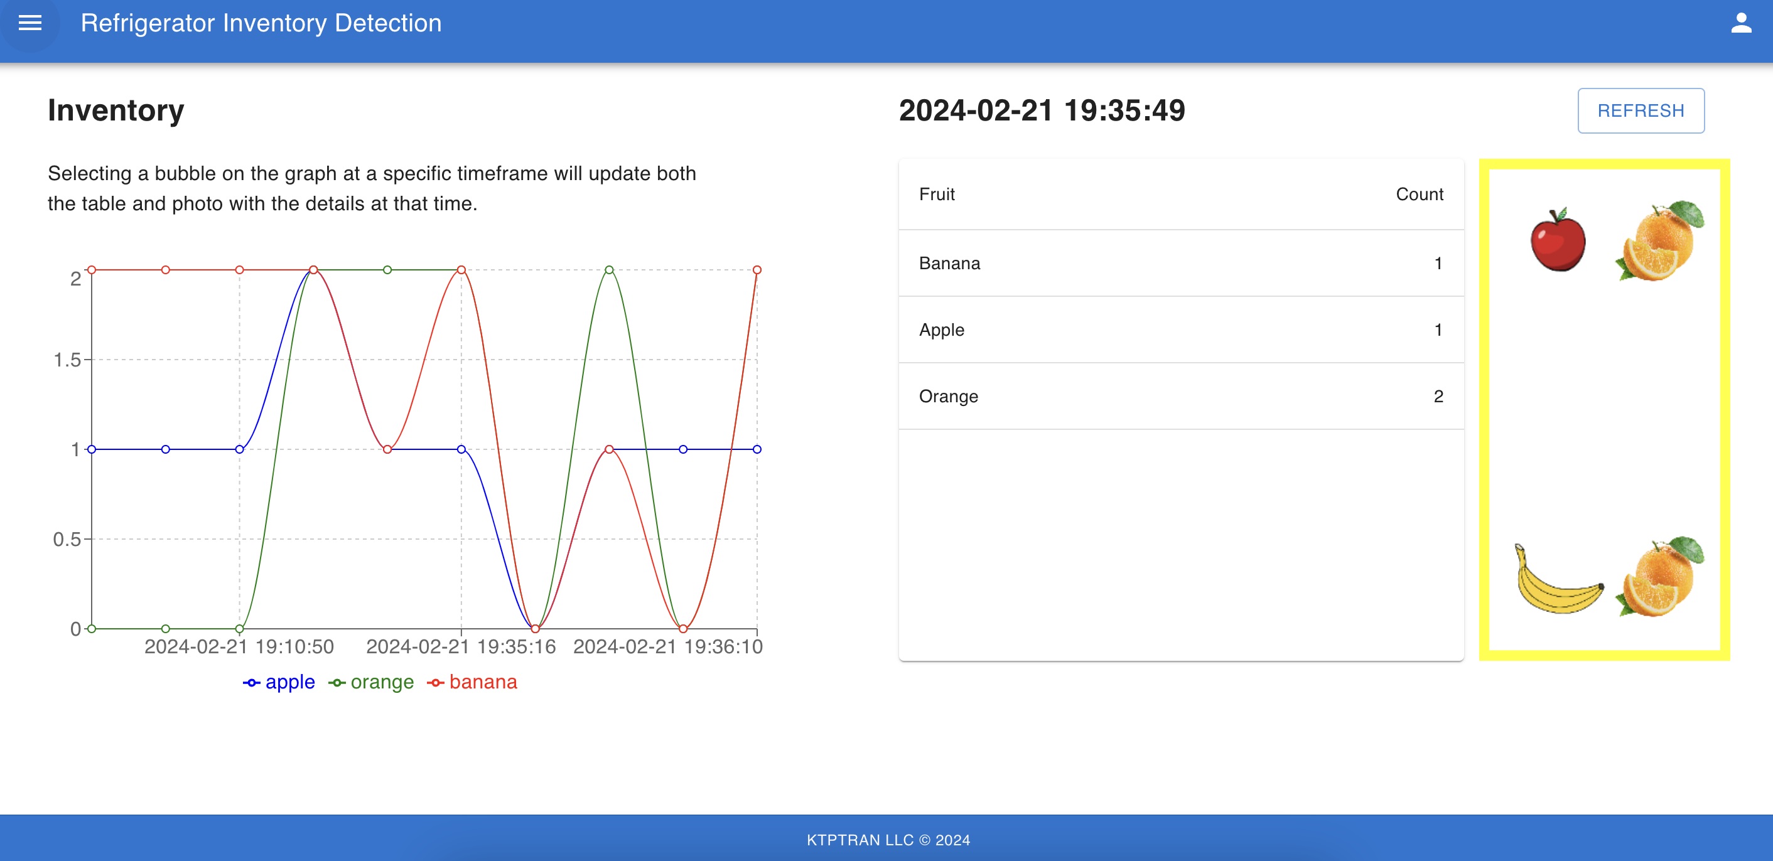
Inventory Historical View
With a few entries, navigate to the inventory page through the sidebar. Here you can view the inventory at any specific time and retrieve its associated image.

Slide 11
Future State

Slide 12
Project Timeline
Sprint 1
(2/13-2/23)
Sprint 2
(2/26-3/8)
Sprint 3
(3/11-3/22)
Web interface security
Point-in-time retrieval of historical snapshot
Project assets
Web interface platform
User authentication
Snapshot workflow
Amazon Rekognition Model training
Inventory count workflow
Historical view page

Slide 13
Platform Expenses
Web Hosting Platform
AWS WAF
Amazon CloudFront
Amazon S3
Backend Processing
Amazon Cognito
Amazon API Gateway
Amazon Rekognition
AWS Lambda
Amazon Timestream
User Data
Inventory detection model data
Snapshot image asset storage
Inventory record storage

Slide 14
Additional Features
AWS Rekognition model accuracy: scaling images to tens of thousands to increase model accuracy
IoT Ingestion: Utilizing IoT devices such as cameras to automatically generate snapshots of real-life inventory
AI/ML Inventory Prediction: Using historical data conduct data analytics for predicting the inventory of fruits using Amazon Forecast.

Slide 15
Kevin Tran
Cloud Consultant
kevintptran@gmail.com
https://www.linkedin.com/in/ktptran/

Slide 16
Appendix
Example Case Study: https://aws.amazon.com/blogs/machine-learning/build-an-automatic-inventory-solution-using-public-datasets-with-amazon-rekognition-custom-labels/
Community Showcase Blog: https://aws.amazon.com/blogs/machine-learning/amazon-rekognition-custom-labels-community-showcase/

